Slide 1
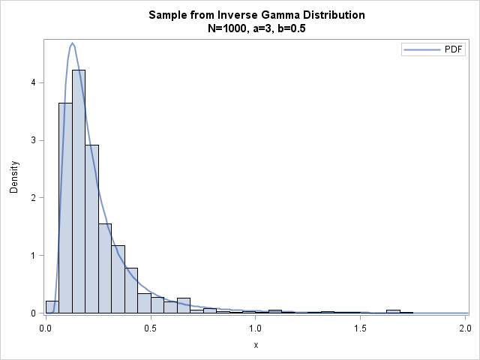
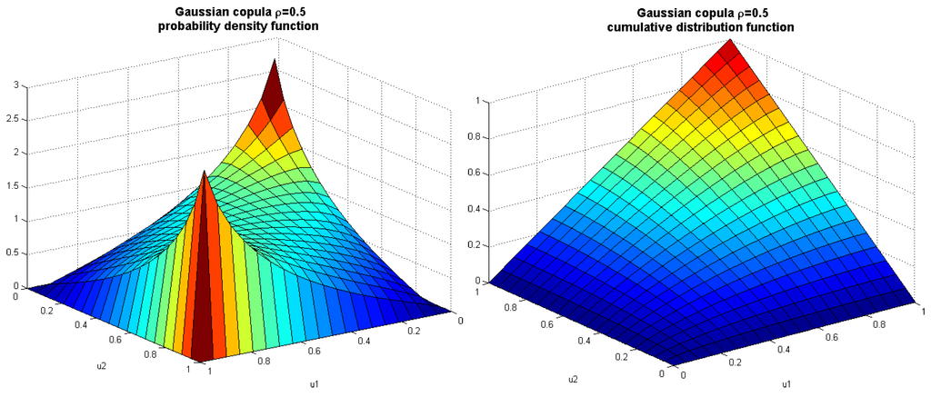
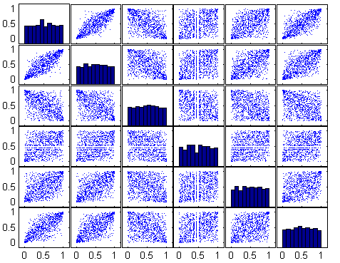
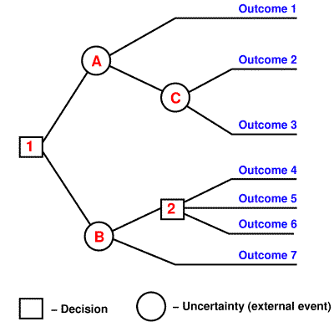

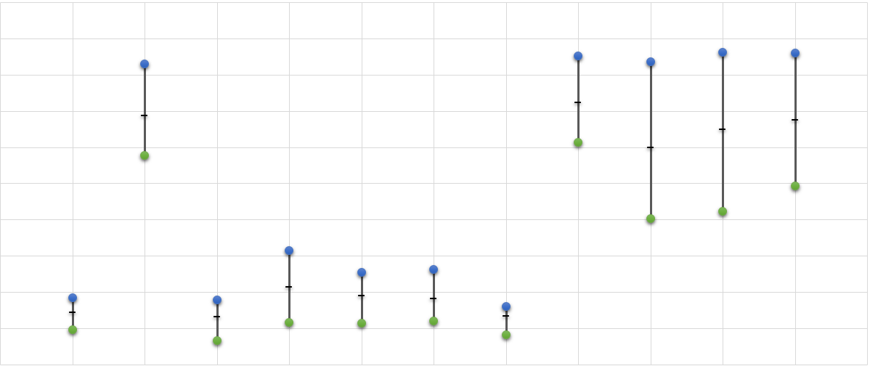
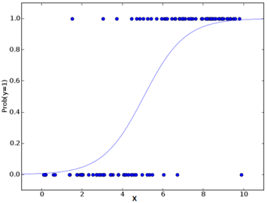
1. Kernel density estimates of given distributions
2. Copula Samples
3. Joint (Correlated) Distribution
Synthesize correlation structure among observations
5. Decision Tree Classifier
4. Expert Threat Judgement Elicitation based on requirement
7. RCP Answers
Or
6. Logistic Regression

